Slide 1

SVKM’s Institute of Technology, Dhule Department of Information Technology
Major Project Presentation​
On​
“Reason of Price Inflation of crop detection to mitigate market manipulation”​
By
Name of group members.
1)More Gunjan (14004200024)
2)More Maitry (14004200025)
3)Sonawane Harshal(14004200052)
4)Bhise Tejaswini(14004200008)
Guide
Prof.NiteenDhutraj

Slide 2
Contents
Project Group
Project Motivation
Problem Statement
Project Abstract
Approach to solve the problem / Technology stack
System Architecture
Use Case
Conclusion
References

Slide 3
Project Details
Project Title: Intentional storage of crop detection to mitigate market manipulation and artificial price rise
Project Domain: Ease of Farming using ML
Project Group Members:
1)More Gunjan(14004200024)
2)More Maitry(14004200025)
3)Sonawane Harshal(14004200052)
4)Bhise Tejaswini(14004200008)

Slide 4
Motivation
The Motivation behind the project is to address crucial challenges in the agricultural sector. As there is not such prominent system to detect the price inflation. Market manipulation and lack of transparency can negatively impact farmers' livelihoods and hinder the growth of the industry the project intends to foster transparency, empower farmers with informed decision-making, and mitigate unethical practices in the agriculture market, ultimately leading to a more sustainable industry

Slide 5
Problem statement
The project aims to solve the challenges of market price inflation and to know the actual reasons behind the price hike in market which tends to mitigate the unethical practices and to know the reasons behind price hike in market.

Slide 6
Objective
The prime objective of our project is to determine the main reason behind the price inflation in market related to agricultural domain to mitigate the price fluctuation.

Slide 7
Aim
By leveraging data-driven technologies, the project aims to know the knowledge behind and reasons behind price inflation, timely and accurate information on crop yields, market trends, and pricing dynamics. This empowerment will enable farmers to make well-informed decisions, optimize their production, and improve their economic prospects.

Slide 8
Abstract
The project addresses reasons impact on agricultural market price volatility through its goals: detecting main reasons behind price hike using historical data, predicting crop prices via historical, weather, and market factors, and forecasting yields using regression models and weather data. The outcome aims for stable markets benefiting stakeholders.

Slide 9
Approch to solve the problem
Step 1: Data Collection and Preparation
Gather comprehensive historical data on vegetable prices, production levels, weather conditions, market demand, and supply.
Preprocess the data by handling missing values, outliers, and normalizing features.
Step 2: Feature Engineering
Extract relevant features from the data, including price trends, seasonal patterns, weather variables, and market indicators.

Slide 10
Approach to solve the problem
Step 3: Anomaly Detection price inflation.
Label instances of price inflation using abnormal price fluctuations or production patterns. Train a supervised learning model (e.g., Random Forest, Gradient Boosting) to detect and classify intentional storage instances.
Step 4: Integration with Django Framework
Utilize the Django framework to build a user-friendly interface/dashboard. Design an interactive website allowing stakeholders to input data and receive predictions. Integrate the trained machine learning models to provide real-time insights through the interface.

Slide 11
Litrature Survey
Sr. no | Reference Name (Write Paper Title) | Seed Idea/ Work description | Problems found | Any other criteri a
1 | Crop price manipulation using Supervise learning Dilip Makji, Bhushan Chaudhari (IJRT)2020 | In this paper, they predicted the price of different crops by analyzing the previous rainfall and WPI data. | Lack of intelligibility of the system | NA
2 | Crop Prediction using Machine Learning Approaches Mahendra N, Ashwini, Sadiq A Mulla, Dr.S.A.Quadri (IJERT) 2020 | The system will suggest the most suitable crop for land based on content and weather parameters. And the system provides information about the required content and quantity of fertilizers, required seeds for cultivation | Problem in controlling, analogue system | NA
3 | Crop yield softwareion using machine learning Holmgren P, Dr, B V Roy IJERT 2021 | Implementation of such a system with an easy-to-use web based graphic user interface and the machine learning algorithm will be carried out | Problem found was lack of GUI facility for user. | NA

Slide 12
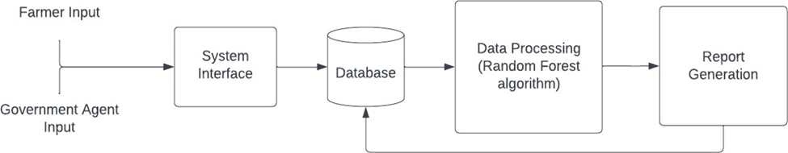
System Architecture

Slide 13
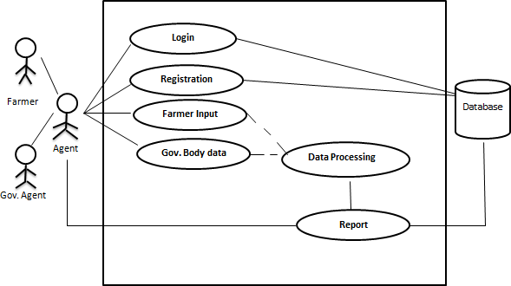
Use case Diagram

Slide 14
Conclusion
In conclusion, the "Intentional Storage of crop detection to mitigate market manipulation and Artificial Price" project offers a proactive response to intentional storage practices that disrupt agricultural markets. By deploying advanced machine learning techniques, we can detect anomalies, predict prices, and forecast yields. This integrated approach fosters market stability and empowers stakeholders with informed decision-making. Through innovation and collaboration, we envision a future where agricultural markets thrive, benefiting everyone from farmers to consumers.

Slide 15
REFERENCES
Technical Paper References:
[1] Kusum Lata, Bhushan Chaudhari,“CROP YIELD PREDICTION USING DATA MINING TECHNIQUES AND MACHINE LEARNING MODELS FOR DECISION SUPPORT SYSTEM” Journal of Emerging Technologies and Innovative Research, Volume 6, Issue 4, April 2019.
[2] Sadiq A Mulla, Dr.S.A.Quadri, “Crop-yield and Price Forecasting using Machine Learning”, The International journal of analytical and experimental modal analysis, Volume XII, Issue VIII, August/2020.
[3] Holmgren P, Thurston T Satellite remote sensing for forestry planning: a review. Scan J For Res 13(1):90– 110, 1998
[4] Jaiprakash Bisen Agriculture market reform market (eNAM) in India National rise research 7535006
[5]Rakesh Rathod, shubham Panda, Changing Resepective Agriculture, IAASCA 2019[6]Bajrang Lal, Agriculture market as casatlyst for Rural Marketing IJRMEC, ISSN 2250-057x August 2017
[6]Agus Diwi Nugroho Agriculture Market Information in developing Agriculture Econimics AGRICECON 2021
Book References:
[7] Jogindar Singh,”agriculture market trade and price” Kalyani
[8] Sawlia Bhihari Varma, agriculture marketing, scientific
[9] Nilabja Ghosh, India’s agriculture marketing, Springer
Magazine Reference
[10]The National AGRICULTURE Magazine, Agriculture Today VOLUME XXVI I88UE 5 MAY 2023

Slide 16
Thank you

